Slide 1
To do
Add chla and cyanoabund biplots without lmh points

Slide 2
Cautionary note
Don’t trust constructed reality
Script all analyses
Don’t believe everything R tells you
Taxonomy matters
Reproducible Research-Github link

Slide 3
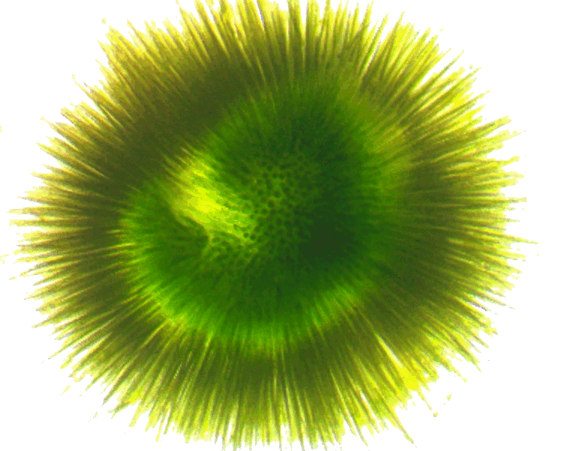
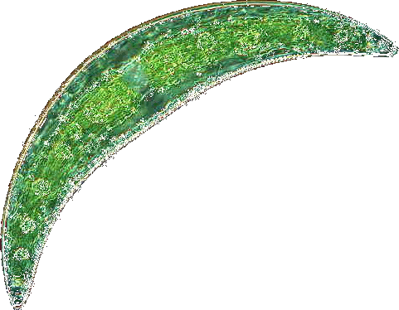


Phytoplankton community composition and cyanotoxin detection among lakes included in the 2007 National Lake Assessment
Betty J. Kreakie¹ , W. Bryan Milstead¹, Jeffrey W. Hollister¹, Elizabeth D. Hilborn¹, & Keith A. Loftin²
Ecological Society of America
August 2017
¹U.S. Environmental Protection Agency
²U.S. Geological Service

Slide 4

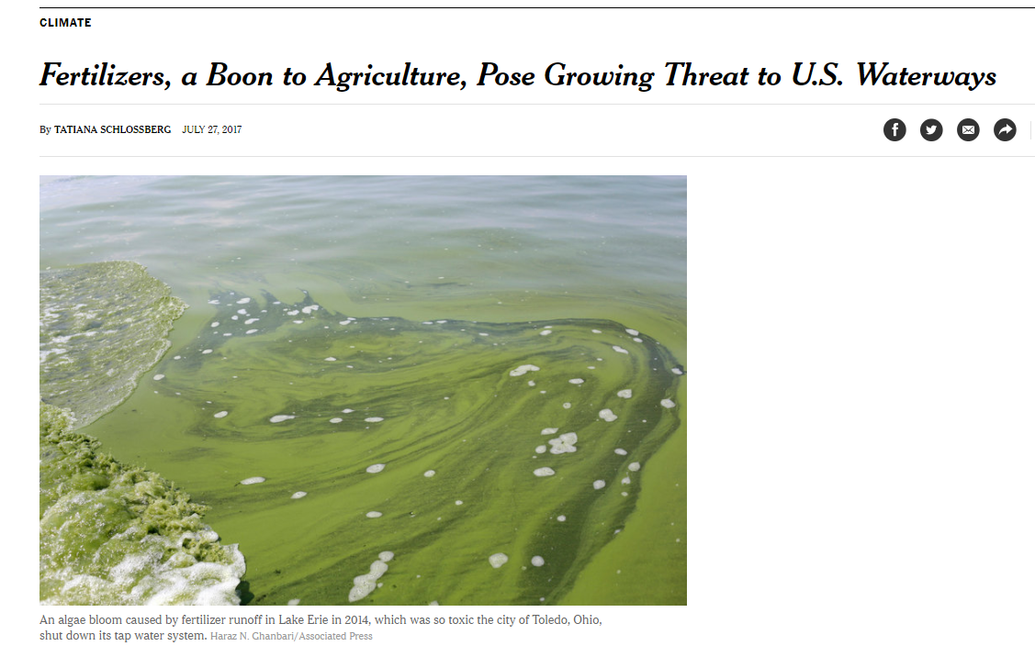

Slide 5

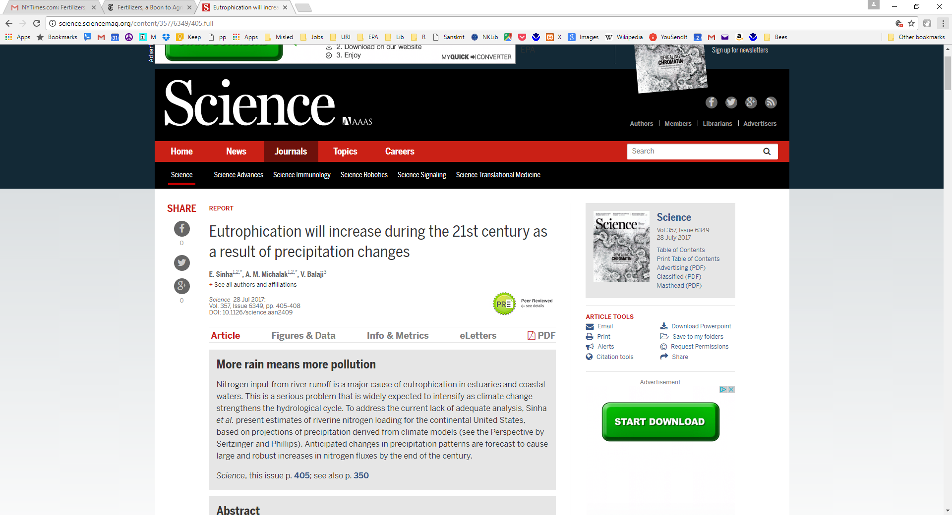

http://science.sciencemag.org/content/357/6349/350.full
http://science.sciencemag.org/content/357/6349/405.full

Slide 6
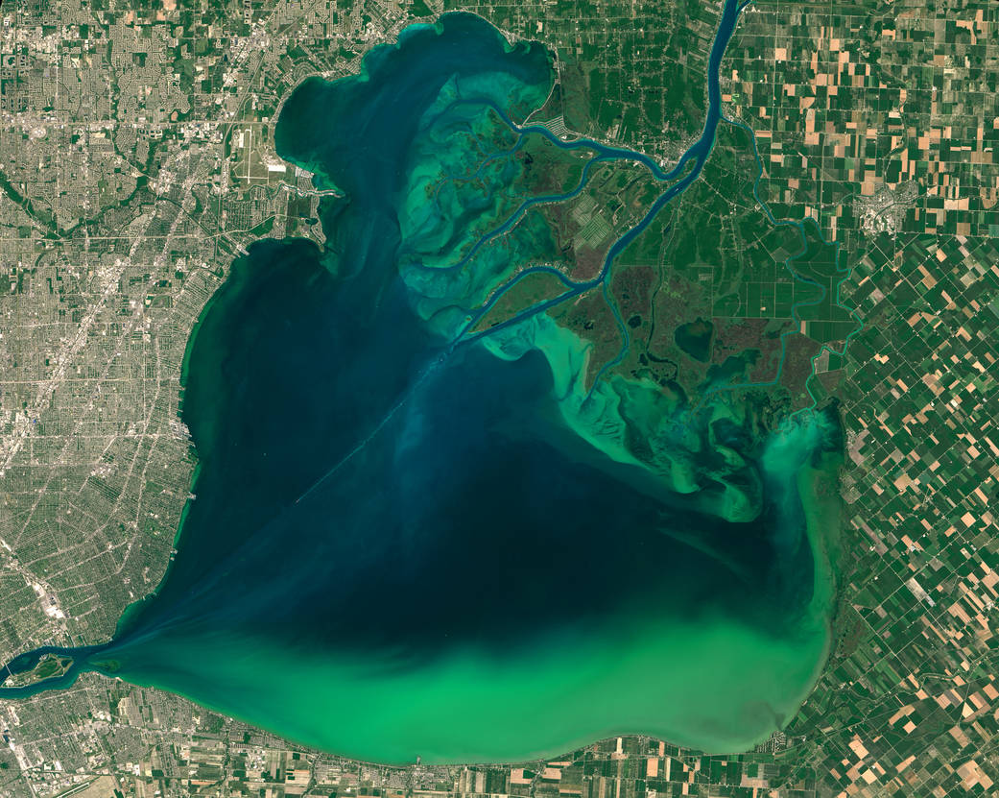
Blooms vs. Toxins?
Notes:
Not just agriculture-other anthropogenic sources also important
Blooms are part of the story- Toxicity also important.

Slide 7
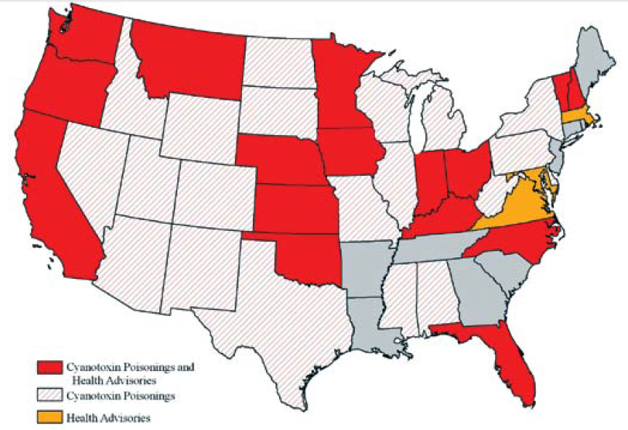
At least 36 States and 50 Countries have reported cyanotoxin poisonings
Graham et al 2009 http://ks.water.usgs.gov/studies/qw/cyanobacteria/LLsummer-graham2.pdf

Slide 8
Cyanotoxins and Potential Producers
From: Loftin, et al. (2016). Harmful Algae 56: 77-90. http://dx.doi.org/10.1016/j.hal.2016.04.001

Slide 9
EPA Health Advisory Concentrations for Microcystins and Cylindrospermopsin
Drinking water health advisory:
Microcystin: 1.6 µg/L adults; 0.3 µg/L preschool children
Cylindrospermopsin: 3 µg/L adults; 0.7 µg/L preschool children
EPA, Office of Water, 820F15003, June 2015
Recreational Ambient Water Swimming Advisories:
Microcystins: 4 µg/L
Cylindrospermopsin: 8 µg/L
“If used as a swimming advisory to protect swimmers at a beach, these values are not to be exceeded on any single day”
EPA, 822-P-16-002, December, 2016

Slide 10
Questions:
Are there identifiable phytoplankton community types across the coterminous United States?
Is cyanotoxin detectability related to phytoplankton community type?
What are the environmental or biotic determinants of community type?

Slide 11
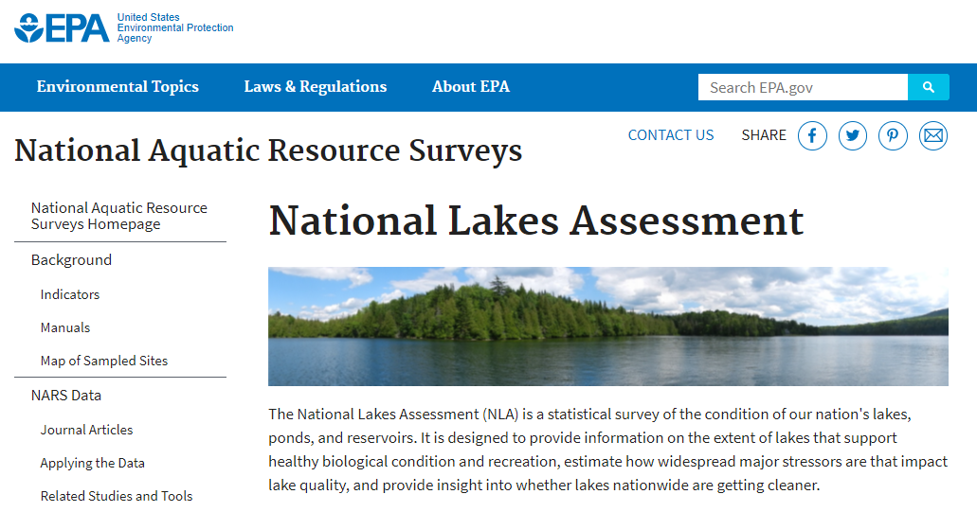
Data Sources
https://www.epa.gov/national-aquatic-resource-surveys/nla
Data from the 2007 National Lake Assessment.
1148 lakes with complete physical, chemical and biological data selected for analysis.
Phytoplankton identified to genus and enumerated
Total sample cyanotoxin (microcystin, saxitoxin, cylindrospermopsin) concentrations measured by ELISA (Loftin et al 2015 http://dx.doi.org/10.3133/ds929)

Slide 12
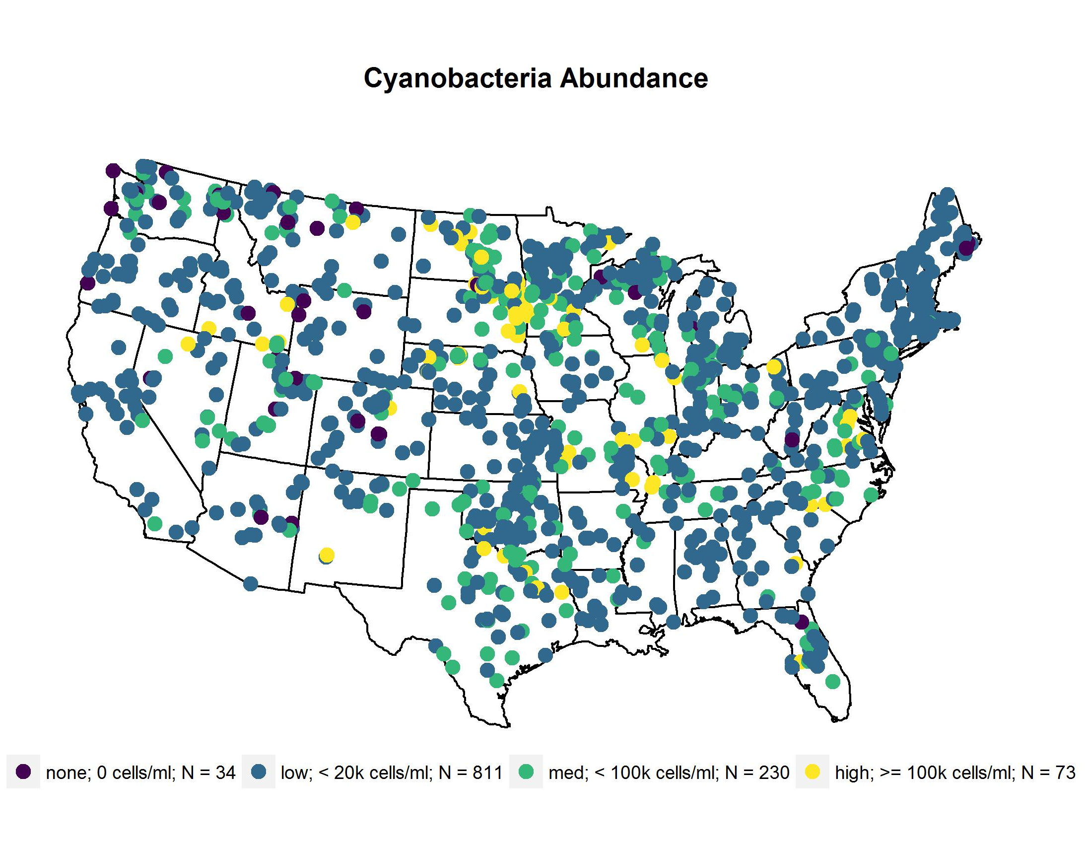
Sample Sites

Slide 13
Methods - Analysis
Genus level phytoplankton abundances analyzed by non-metric multidimensional scaling (NMDS)with R and metaMDS procedure in the Vegan Package
Cluster analysis used to define lake groupings with vegdist procedure (vegan) and hclust (stats)
Indicator species analysis the indval procedure (labdsv)

Slide 14
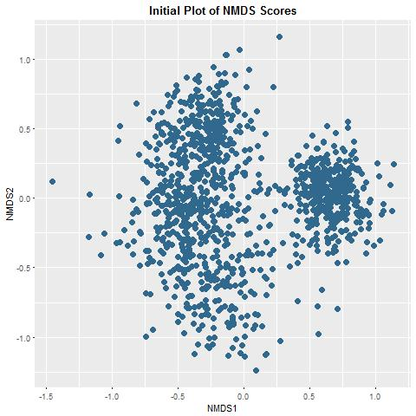
Non-Metric Multidimensional Scaling Analysis
Of Phytoplankton Abundances (Genera)
R Vegan Package: metaMDS Procedure
Wisconsin Square Root Transformation
Data Centered, Scaled, and Rotated
10,000 runs with random starts
4 Dimensions
Failed to converge
Stress = 0.178
N = 1148 lakes

Slide 15
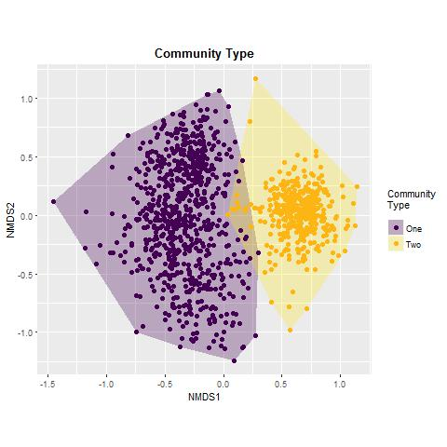
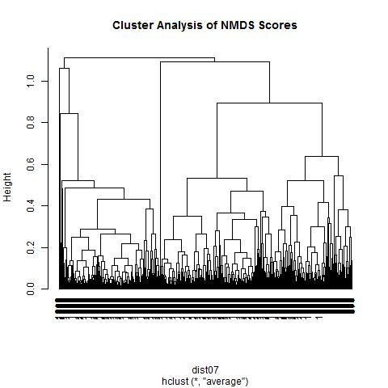
2
1
1

Slide 16
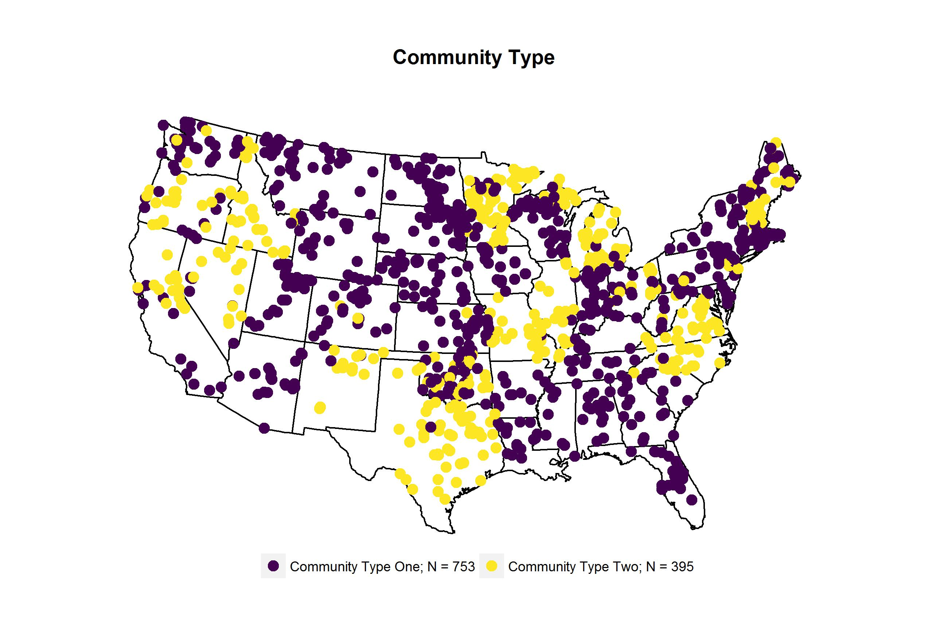

Slide 17
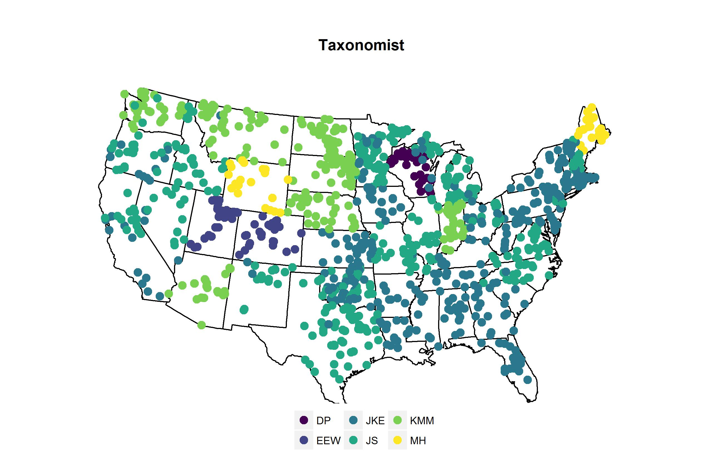

Slide 18
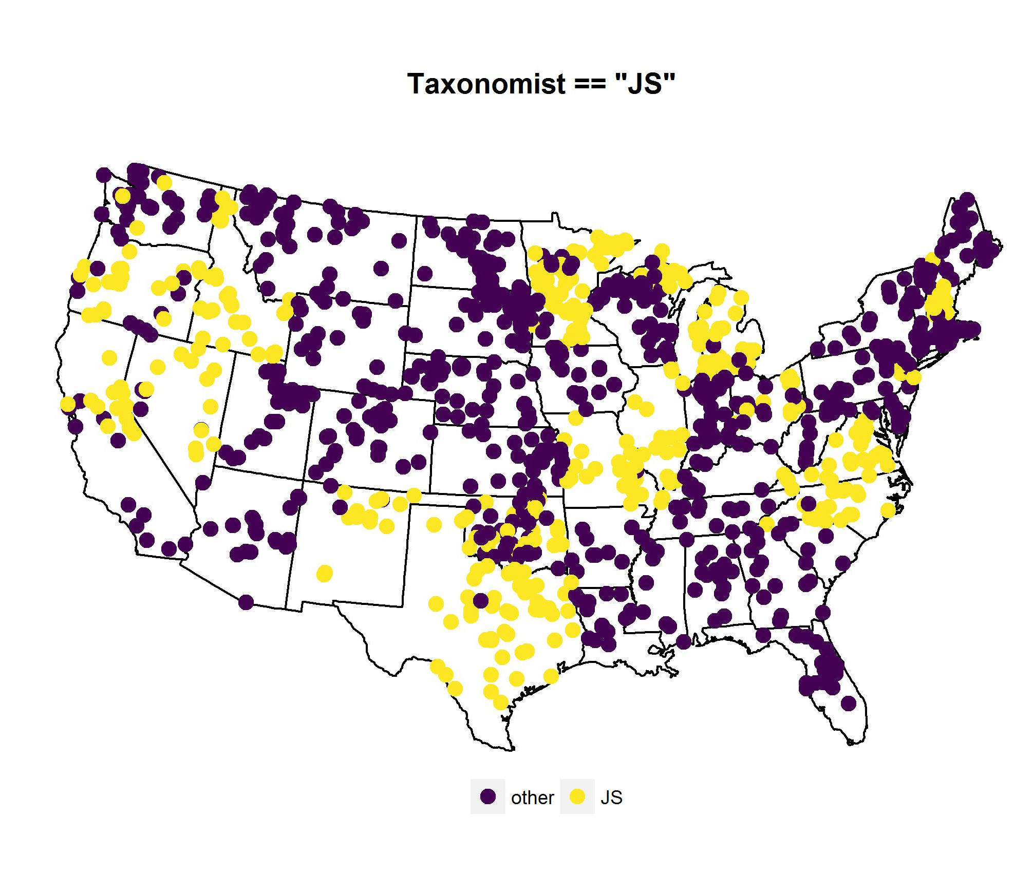
Notes:
Lester Yuan

Slide 19
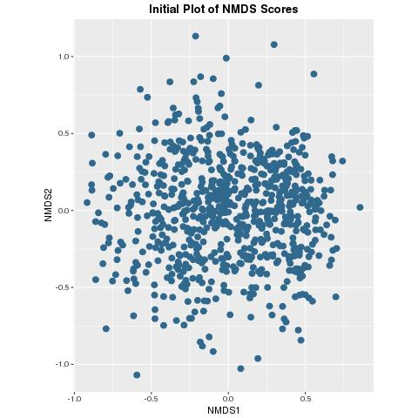
Non-Metric Multidimensional Scaling Analysis
Of Phytoplankton Abundances (Genera)
“JS” sites removed
R Vegan Package: metaMDS Procedure
Wisconsin Square Root Transformation
Data Centered, Scaled, and Rotated
10,000 runs with random starts
4 Dimensions
Failed to converge
Stress = 0.195
N = 1148 764 lakes

Slide 22
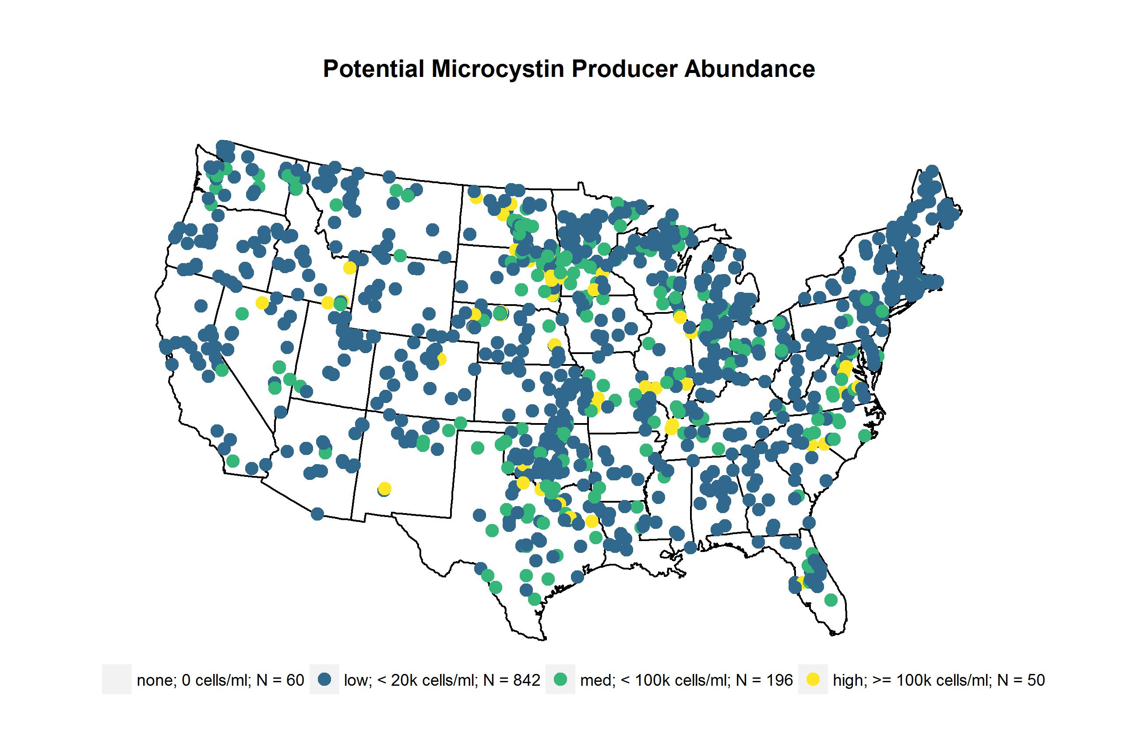
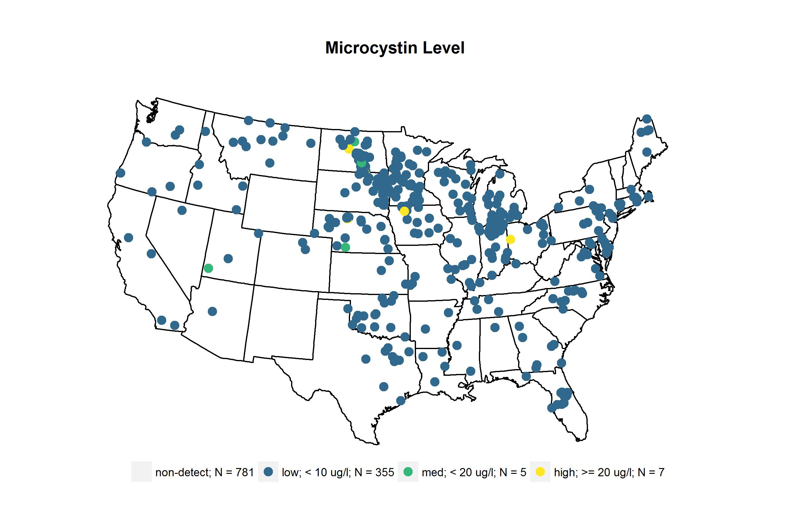
 | Lakes | cells/ml
genus | n | median | mean | max
Anabaena + Dolichospermum | 643 | 312 | 3461 | 13539
Anabaenopsis | 137 | 188 | 1170 | 3536
Aphanocapsa | 397 | 110 | 13406 | 158052
Coelosphaerium | 166 | 891 | 6094 | 36273
Leptolyngbya | 143 | 1062 | 3271 | 8121
Limnothrix | 80 | 676 | 13383 | 51263
Lyngbya | 268 | 174 | 1853 | 5620
Microcystis | 661 | 2953 | 27974 | 204147
 | Lakes | cells/ml
genus | n | median | mean | max
Oscillatoria + Phormidium + Planktothrix | 521 | 239 | 2929 | 14601
Planktolyngbya | 93 | 305 | 1714 | 5530
Pseudanabaena | 106 | 323 | 1802 | 6861
Snowella | 26 | 703 | 2030 | 5357
Synechococcus | 283 | 201 | 407 | 591
Synechocystis | 187 | 490 | 2421 | 8951

Slide 23

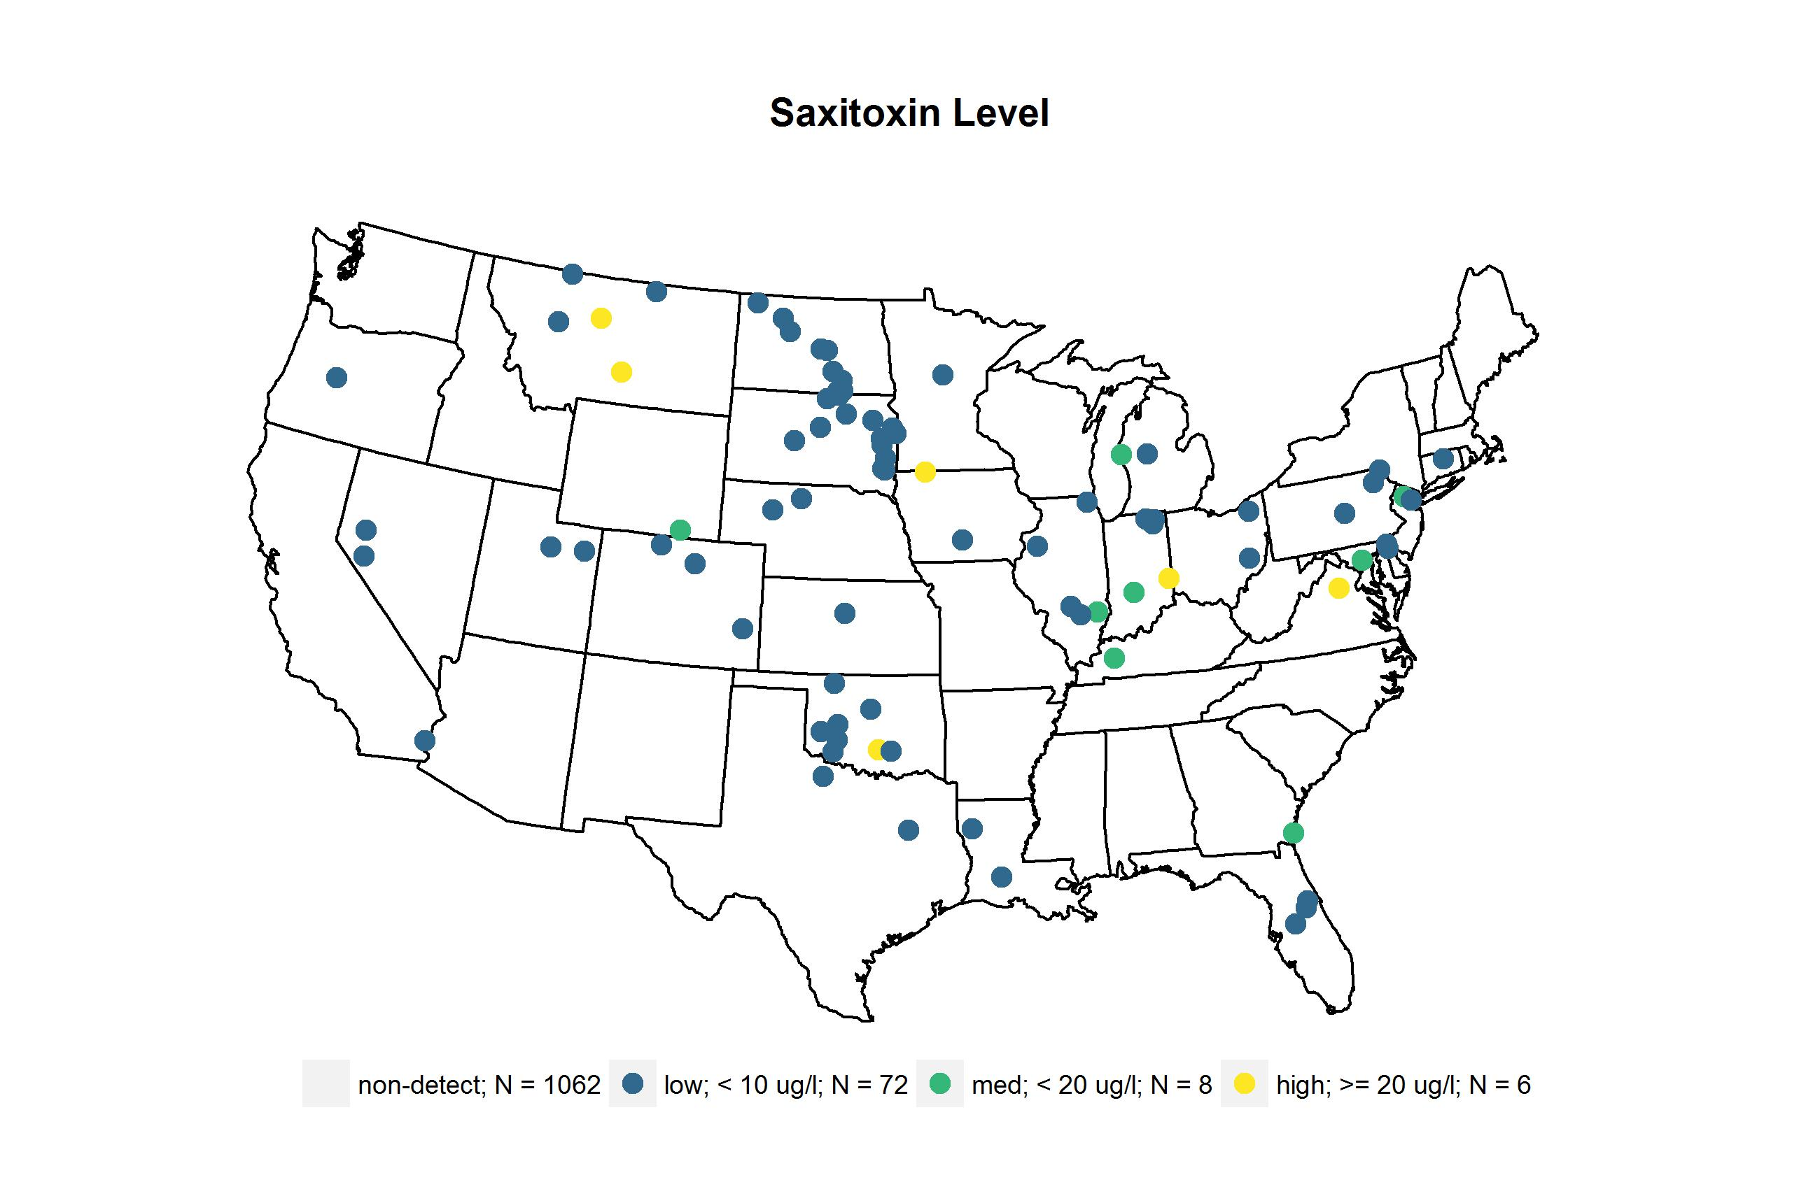
 | Lakes | cells/ml
genus | n | median | mean | max
Anabaena + Dolichospermum | 643 | 312 | 3461 | 13539
Aphanizomenon | 318 | 740 | 8527 | 25923
Cylindrospermopsis | 47 | 438 | 2481 | 5268
Lyngbya | 268 | 174 | 1853 | 5620
Oscillatoria + Phormidium + Planktothrix | 521 | 239 | 2929 | 14601
Planktolyngbya | 93 | 305 | 1714 | 5530

Slide 24

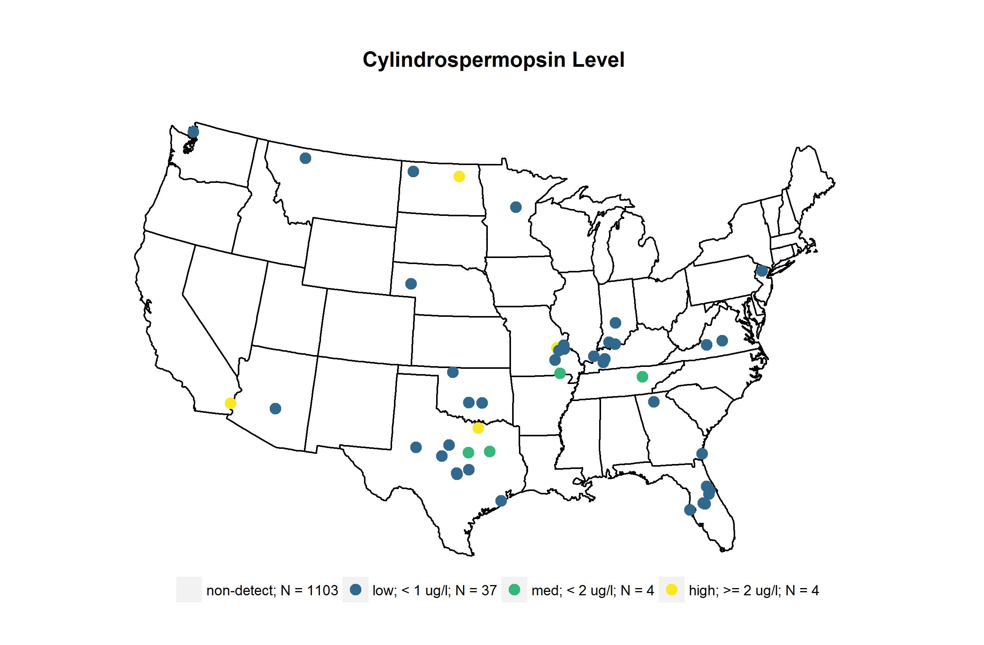
 | Lakes | cells/ml
genus | n | median | mean | max
Anabaena + Dolichospermum | 643 | 312 | 3461 | 13539
Aphanizomenon | 318 | 740 | 8527 | 25923
Cylindrospermopsis | 47 | 438 | 2481 | 5268
Lyngbya | 268 | 174 | 1853 | 5620
Raphidiopsis | 134 | 74 | 1328 | 7030

Slide 25
Table of phyto taxonomy

Slide 26
Question: are there patterns of community type

Slide 27
Question: are there patterns of community type
Conclusions:
two distinct community types identified
Possible spatial pattern to community types

Slide 28
Question: relationship btw community type and cyano abund/toxin

Slide 29
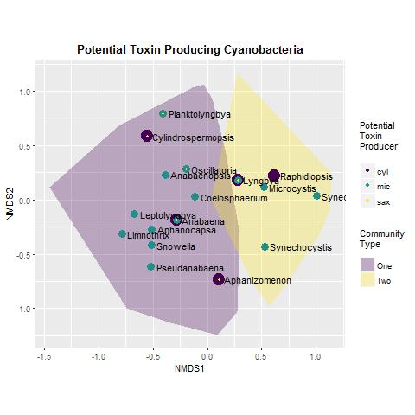
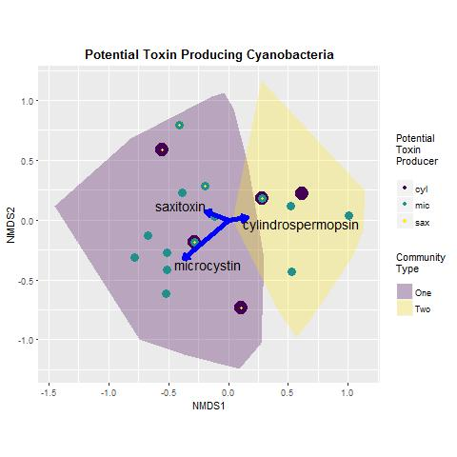

Slide 30
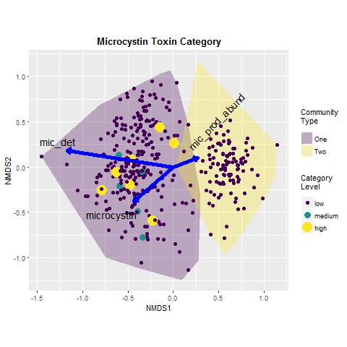
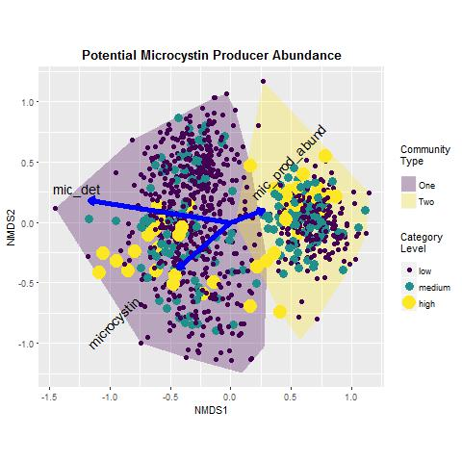

Slide 31
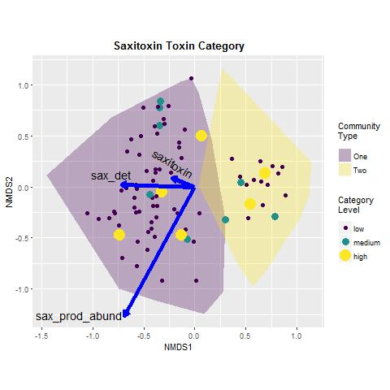
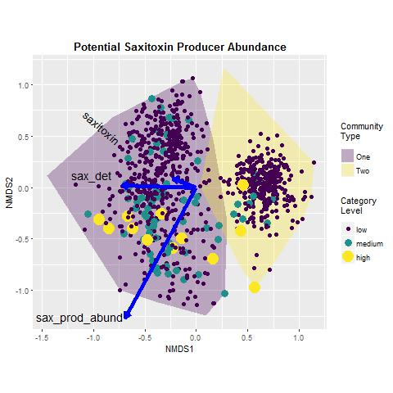

Slide 32
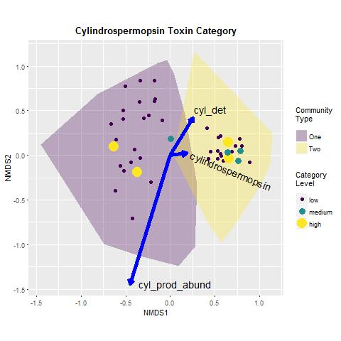
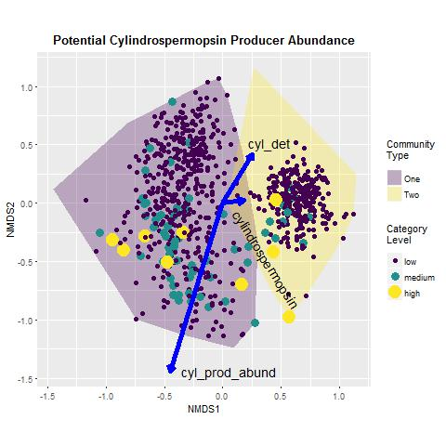

Slide 33
Question: relationship btw community type and cyano abund/toxin
Conclusions:
Clear identification of each toxin with one community type
No relationship between the abundance of potential toxin producing genera and toxin detections or concentrations

Slide 34
Question: What are the environmental or biotic determinants of community type?
Conclusions:
Lake community types are strongly associated with eutrophication indicators
Each lake community type has distinct indicator species; at this point we cannot interpret the results because we have not idea what we are doing as phycologists

Slide 35
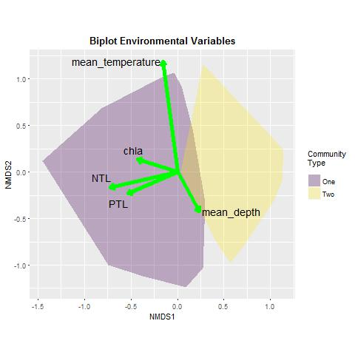

Slide 36
Conclusions:
From the three previous conclusion slides

Slide 37
Next Steps:
Investigate characteristics of indicator species
Develop predictions and test with the 2012 NLA data

Slide 38
Thank You
Bryan Milstead
U.S. Environmental Protection Agency
Narragansett RI
milstead.bryan@epa.gov
401-782-3015
Notes:
Not just agriculture-other anthropogenic sources also important
Blooms are part of the story- Toxicity also important.

